Slide 1
Topic: Census & Surveys EQ – How do you design a Questionnaire?
Mrs James
Year 12 Essentials

Slide 2
Learning Intentions
Use your EST content tick list
Students will be able to
Simple survey procedure
3.4.6 identify the target population to be surveyed
3.4.7 investigate questionnaire design principles; for example, simple language, unambiguous questions,
consideration of number of choices, issues of privacy and ethics, freedom from bias

Slide 3
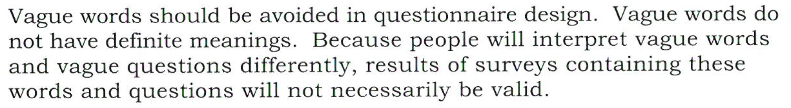
24
7
30
Census & Surveys
Date
EQ – How do you design a Questionnaire?
Wording

Slide 4
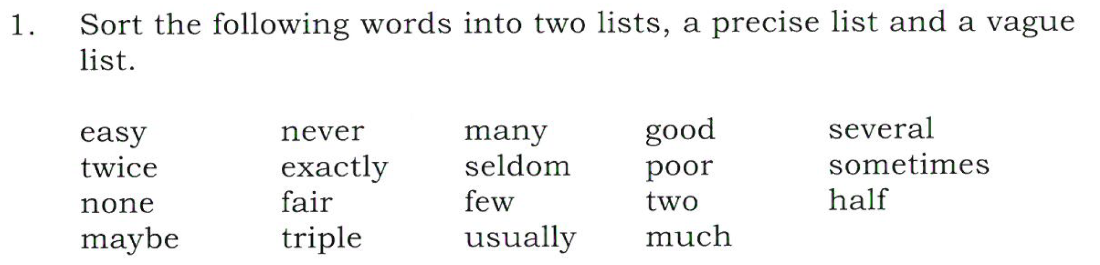
Practice

Slide 5
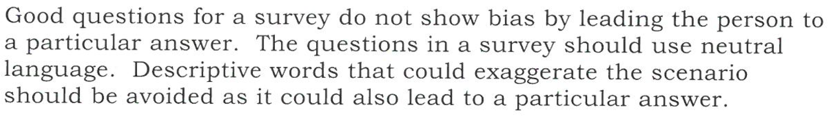
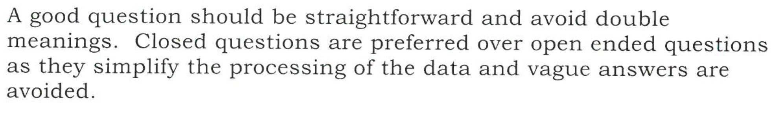
24
7
30
Census & Surveys
Date
EQ – How do you design a Questionnaire?
Questioning

Slide 6
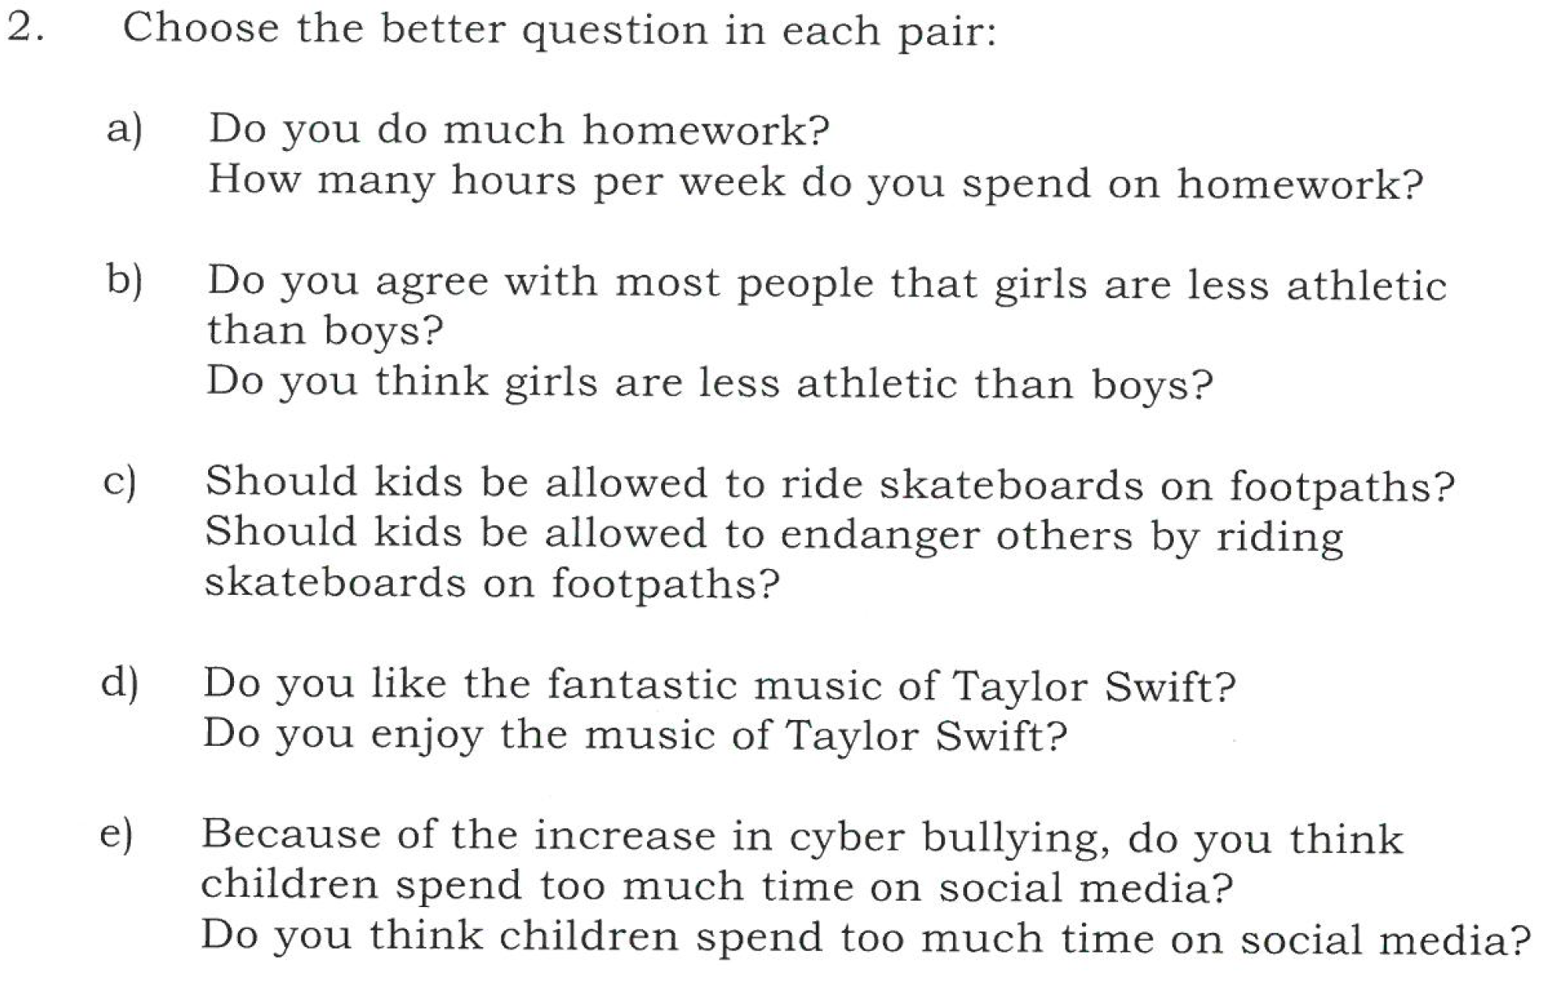
Practice

Slide 7
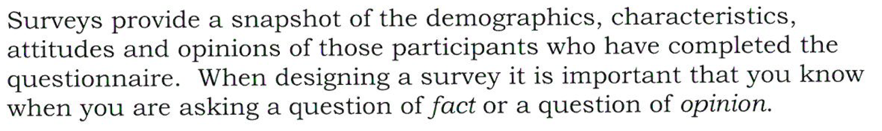
24
7
30
Census & Surveys
Date
EQ – How do you design a Questionnaire?
Type of Questions

Slide 8
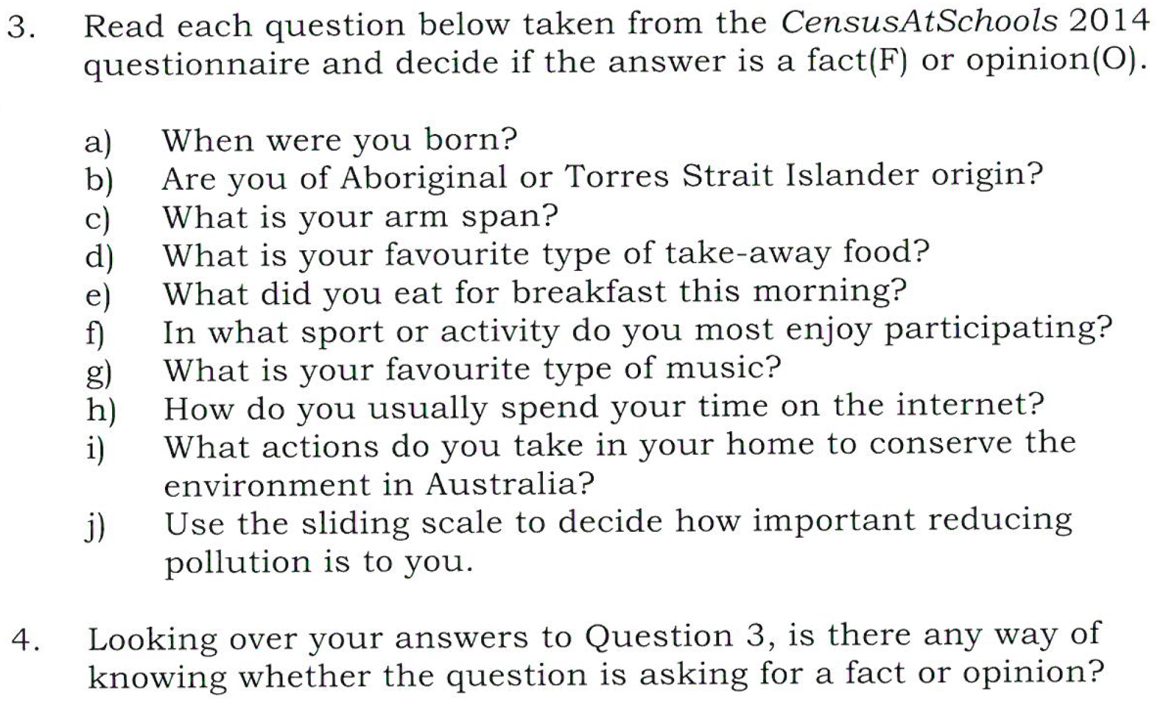
Practice

Slide 9
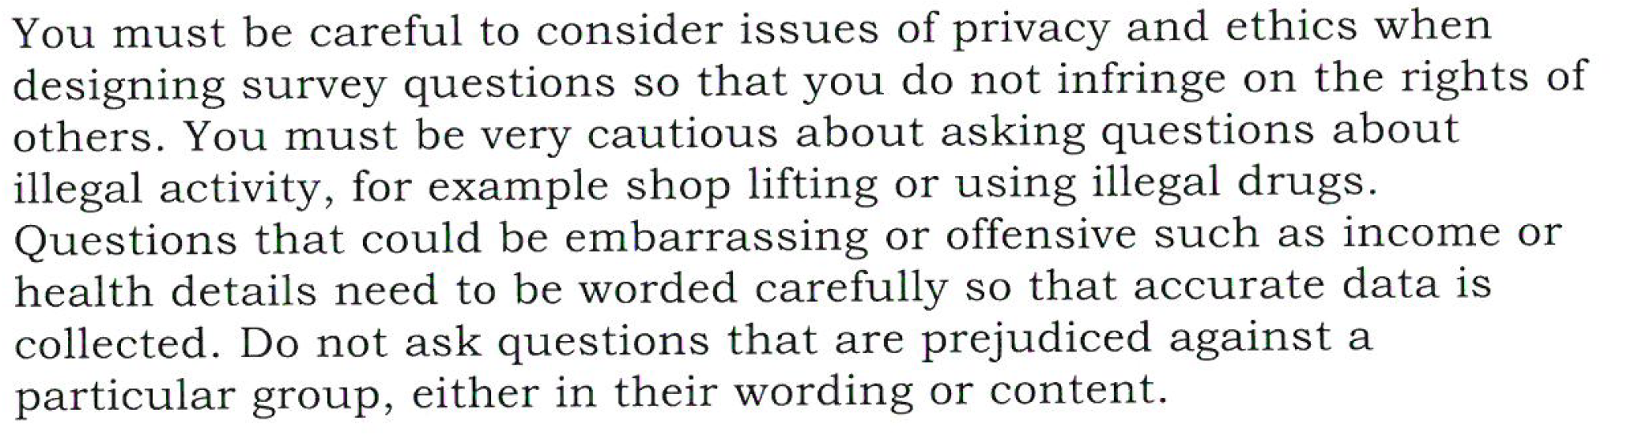
24
7
30
Census & Surveys
Date
EQ – How do you design a Questionnaire?
Privacy and Ethics

Slide 10
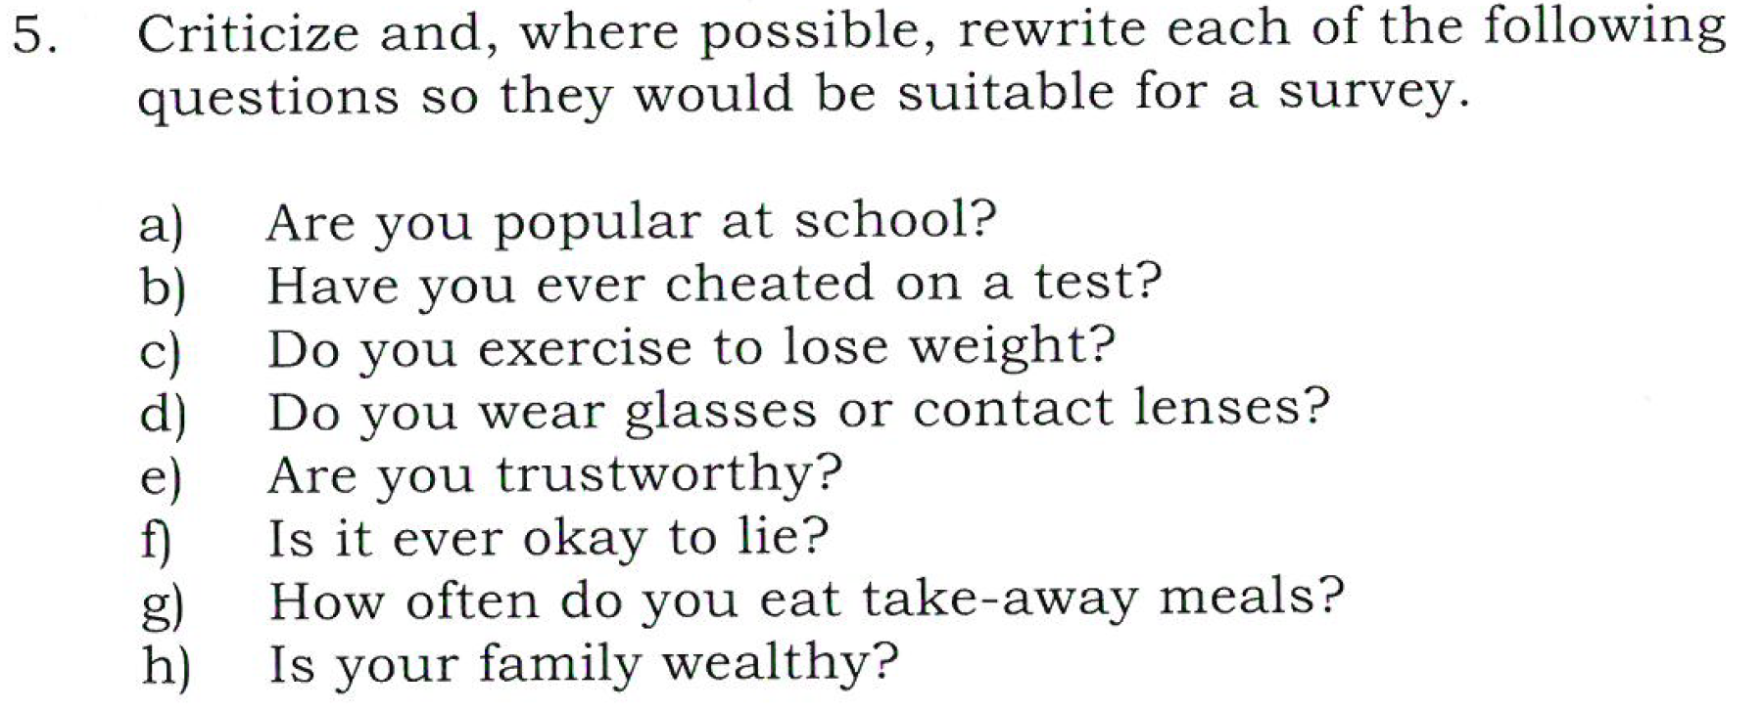
Practice

Slide 11
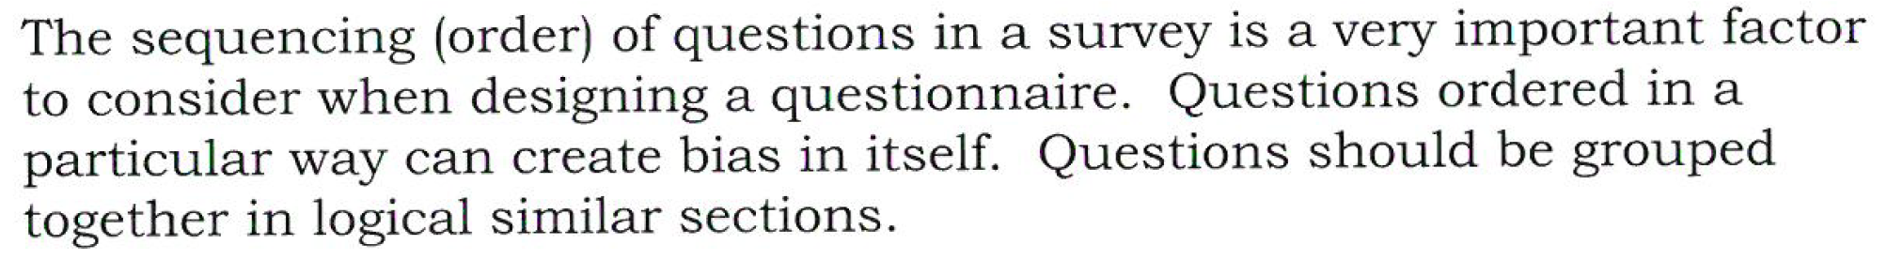
24
7
30
Census & Surveys
Date
EQ – How do you design a Questionnaire?
Order of Questions

Slide 12
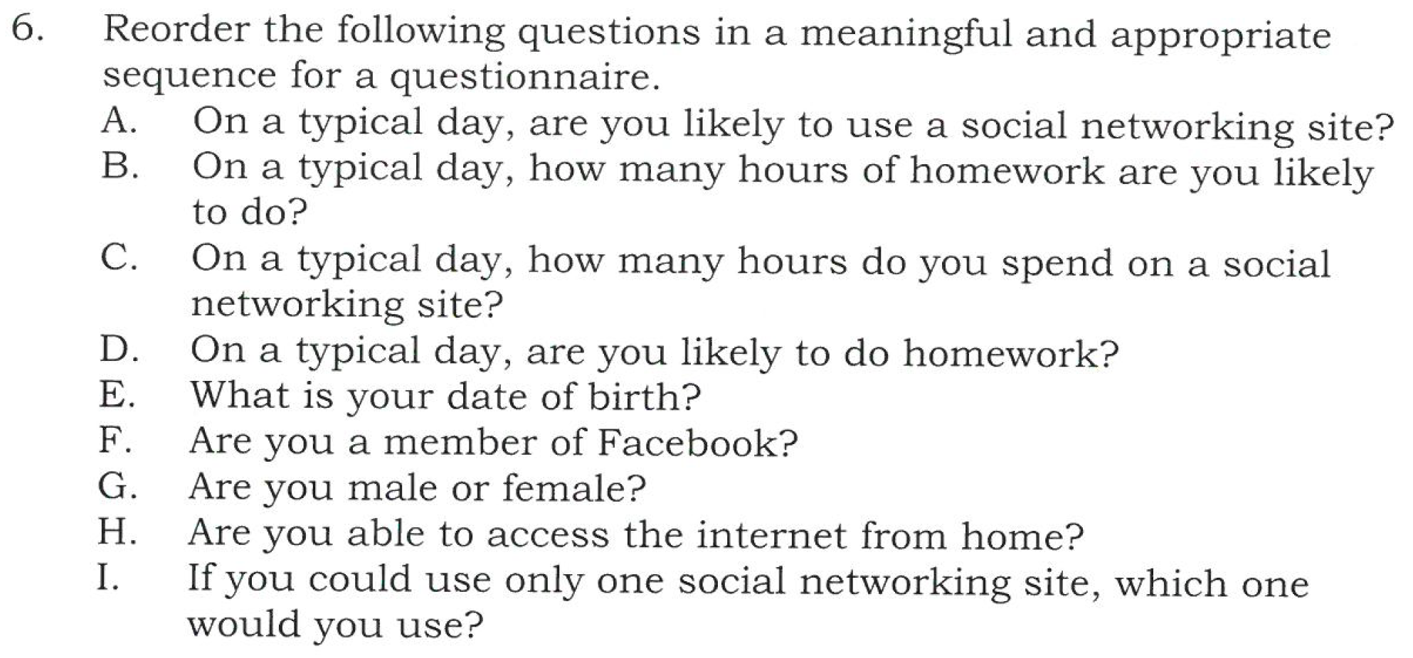
Practice

